Slide 1
Techniques Of Controlling

Slide 2
Learning Outcomes
Students will analyse process and techniques of controlling

Slide 3
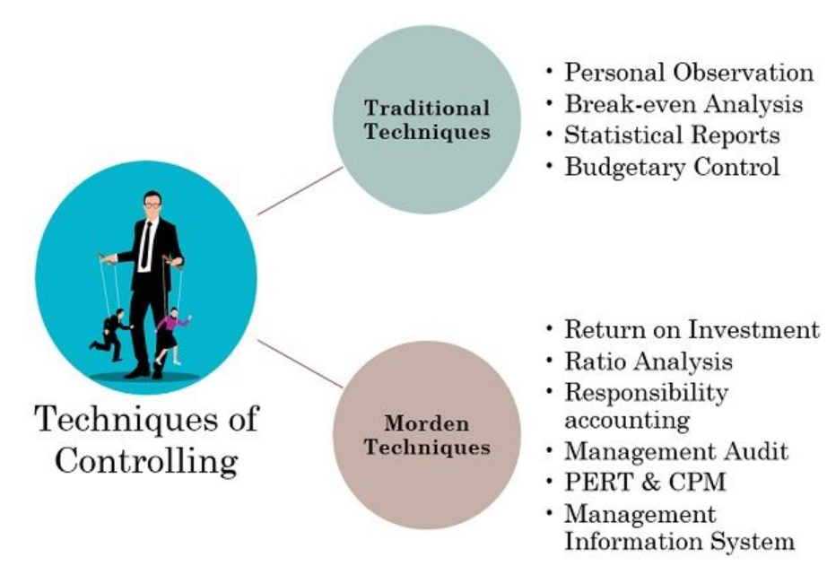
Techniques of Controlling

Slide 4
Techniques of Controlling
Traditional Techniques
As the name suggests, managers have developed and used these techniques for a long period of time. These techniques are still fruitful and used by the firms till date.
Personal Observation
Break-even Analysis
Statistical Reports
Budgetary Control

Slide 5
Techniques of Controlling
Personal Observation
It is the oldest traditional method available to perform the controlling function. In this, the manager personally observes the employees/workers at the workplace.
In simple words, we can understand it as On-the-Spot or Direct Observation.
Break-even Analysis
This control technique depicts the relationship between Cost and Volume at different output levels. It is also known as the Cost, Volume and Profit analysis.
It predicts the profits and losses in response to the changes in the output levels. The point where the cost price equals the selling price is the Break-even point.

Slide 6
Techniques of Controlling
Statistical Reports
The manager gathers information to evaluate performance in functional areas. And they use the collected information for comparison purposes. It involves the analysis of the numeric data in the form of: –
Averages
Percentages
Co-relation
Ratios, etc
The organization presents the above information via Charts, Graphs, Tables, etc. These reports help visualize the data and identify the areas that demand attention. Hence, it is the most used and helpful technique for data analysis.

Slide 7
Techniques of Controlling
Budgetary Control
Budgetary Control is an important traditional control technique used in planning and controlling functions. It covers the planning of the essential operations followed by its comparisons with the actual performance.
The budgeting process includes comparing and evaluating the actual and budgeted performances. The steps in budgeting broadly cover: –
Creating standards by bifurcating the overall business goals into departmental targets.
Comparison of predefined Budget/Standards with the actual performance.
Calculate the logical deviations from the plan and take corrective measures.

Slide 8
Techniques of Controlling
Modern Techniques
Modern control techniques are additions to the management literature. These are of recent origin and provide innovative methods for organizational evaluation and control.
Return on Investment
Financial Statement and Ratio Analysis
Responsibility Accounting
Management Audit
PERT & CPM
Management Information System

Slide 9
Techniques of Controlling
Return on Investment
Return on Investment (ROI) is the profit earned by invested capital. It is analyzed to attain financial control in the business. It is also known as the Du-Pont System of financial analysis.
To measure the generated return, we calculate the rate of ROI. This rate helps assess the financial position of the business.
Financial Statement and Ratio Analysis
It helps in controlling the finances of the organization by calculating different Ratios. For this purpose, data is accumulated from the firms’ financial statements.

Slide 10
Techniques of Controlling
Responsibility Accounting
It is an accounting system that depends upon the responsibility assigned to the employee. So businesses conduct an evaluation of the employee’s ability to fulfil the assigned responsibility as per set standards.
This control technique is suitable for large organizations containing many departments.
Management Audit
Management or Internal Audit is the examination of the utilization of the company’s resources. The Top-level initiates it to ensure the efficient performance of the management.
Internal Auditing starts as soon as the financial audit ends. During the audit, the overall management process is critically evaluated.

Slide 11
Techniques of Controlling
PERT & CPM
PERT is Program Evaluation and Review Technique, whereas CPM stands for Critical Path Method. These control techniques are used explicitly for project management and evaluation.
The activity or project’s success is largely affected by the time taken and steps involved. Therefore managers strive to cut the total time and cost involved in completing the activity.
Management Information System
Management Information system (MIS) basically provides information for effective decision making. Managers can retrieve any data as and when needed. It is one of the cost-effective controlling techniques available for managers.

